Slide 1

















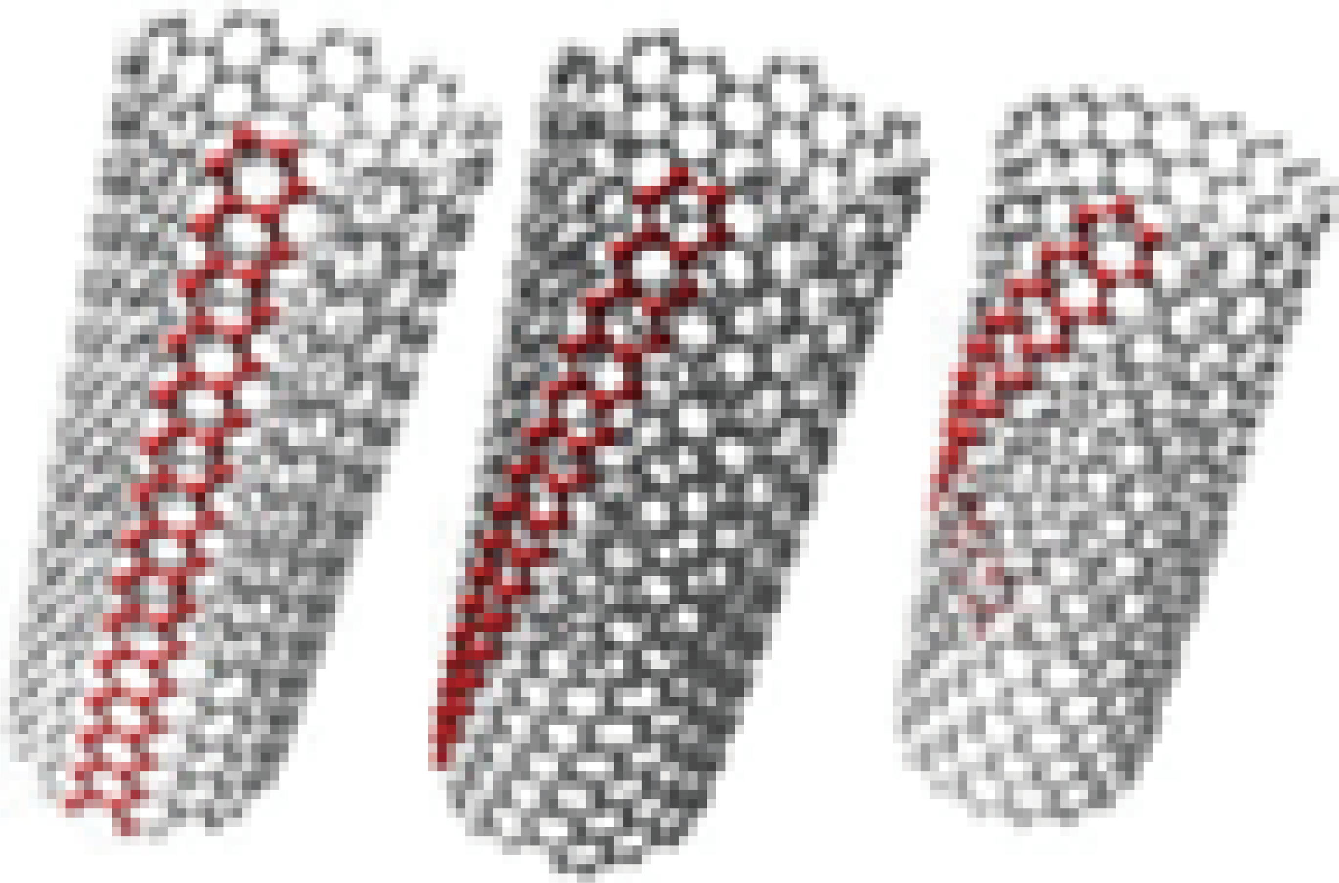
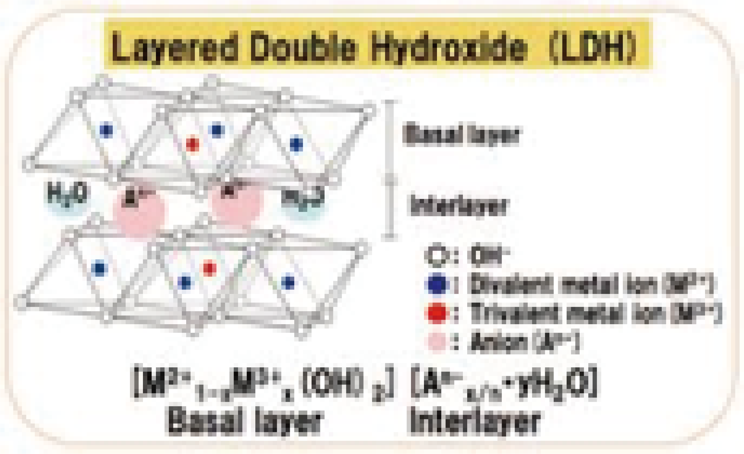


Synthesis of
Carbon Nanotube
Composites
John Smith 1,
Jane Doe 2
1 School of Agriculture, xx University
2 xx Co., Ltd.
Highly effective synthesis of single-layered carbon nanotubes (CNT) succeeded
Synthesis of layered double hydroxide (LDH) in small particle and high dispersibility succeeded
Synthesis of CNT and LDH by coprecipitation process succeeded
Application as a new functional nanomaterials expected
Carbon Nano Tube (CNT)
Layered Double Hydroxide（LDH）
A New Functional Nano Material
Talk with those who are interested in carbon nanotubes!(Medical material specialists are particularly welcomed!)
Collaboration with those who can work in structural analysis and electrochemical evaluation!
Applied development to highly sensitive voltammetry test available!

